Slide 2
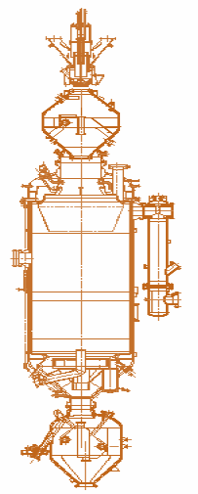
Seminar on “Indian Coal- Potential & Diversification”
Dated-24th September’ 2019
COAL GASIFICATION
Presented to:7th Roundtable Conference on Coal Secretariat

Slide 3
Contents
Global & Domestic Coal Reserves
Selection of Coal Gasification Technology
Coal Gasification Theory
Gasification History & Types of Coal Gasification Technologies
Selection of Fixed Bed Dry Bottom Gasifier
Coal Gasification Complex at JSPL Angul at a Glance
Syn-gas Production route & Units in CGP
Syn Gas integration with DRI Plant
Coal Specifications
Gasification Technology in Brief
Coal Gasification By-Products/downstream products

Slide 4
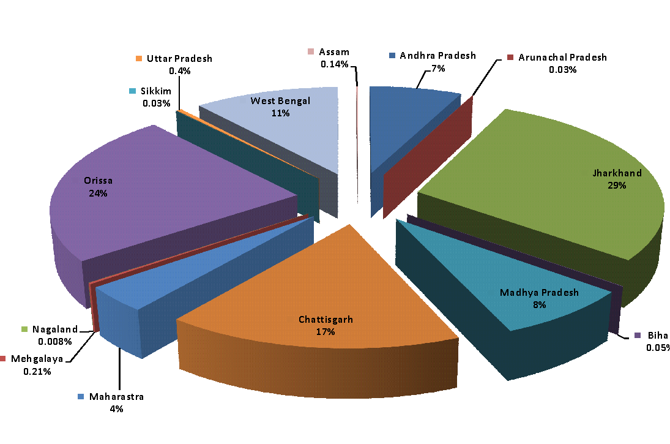
Global & Domestic Coal Reserve
Total Proved Coal Reserves: 223,228 Million Tonnes(Mt)
India, 8.3%
Australia
12.7%
Brazil
0.6%
South Africa
0.9%
USA
22.1%
Germany, 3.2%
China
21.4%
Russia
14.1%
Source: BP Statistical Review 2016
India has 4th largest coal reserve in World: 315,148.81 Million tonnes(Mt) on 1st April 2017
Proven/Measured Coal reserves (India):
Coal for more than 236 years
Category Wise
Coal reserve
Measured
45.4%
Indicated
44.2%
Inferred
10.4%
Non Coking
279,027 Mt
Superior
13.4%
Inferior
75.8%
Ungraded
10.8%
Coal Extracted from Coalfields
2016-17:
644.31 Mt
Since 1950 up to 2016-17: 14438.22 Mt
Source: GSI, NERM 2017
Of the total coal reserves 77% is either Inferior Grade or Ungraded coal Non-Coking Coal
Coal reserves concentrated in Eastern India, Hence CG project based in Angul, Orissa
4

Slide 5
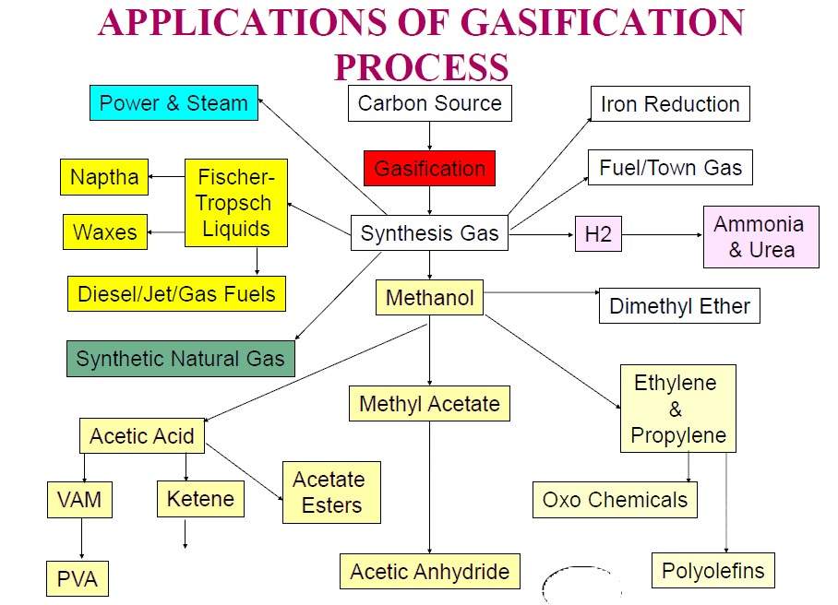
Coal Gasification Theory Contd..
5

Slide 6
Coal Gasification Theory
6

Slide 7
Coal Gasification Theory Contd..
7

Slide 8
Coal Gasification Theory Contd..
8

Slide 9
Coal Gasification Theory Contd..
9

Slide 10
Coal Gasification Theory Contd..
10

Slide 11
Coal Gasification Theory Contd..
11

Slide 12
Coal Gasification Theory Contd..
Reactivity : The reactivity of coal and char depends on various factors in particular
The porosity of coal, that is, its inner structure, surface and active sites
The crystal structure of the fixed carbon
Catalytic effects of ash component in the coal
Young ( Low rank ) coal such as brown coal has high specific surface and thus a high reactivity
Older coal have lower reactivity
Reactivity is enhanced by alkalies , particularly potassium
12

Slide 13
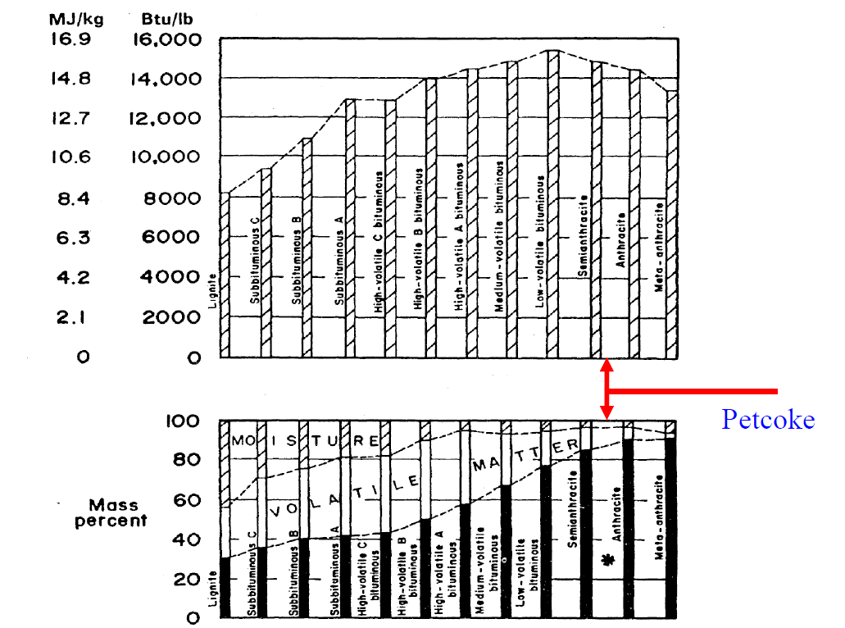
Coal Gasification Theory Contd..
This region is fixed Carbon

Slide 14
Coal Gasification Theory Contd..

Slide 15
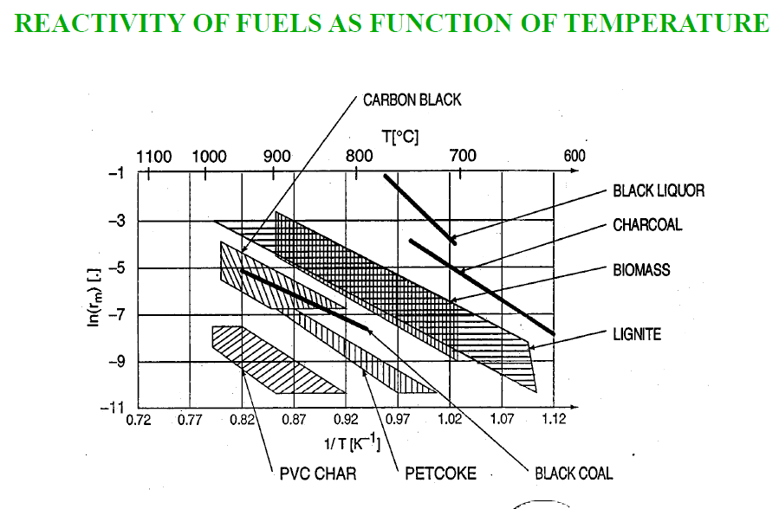
Coal Gasification Theory Contd..
15

Slide 16
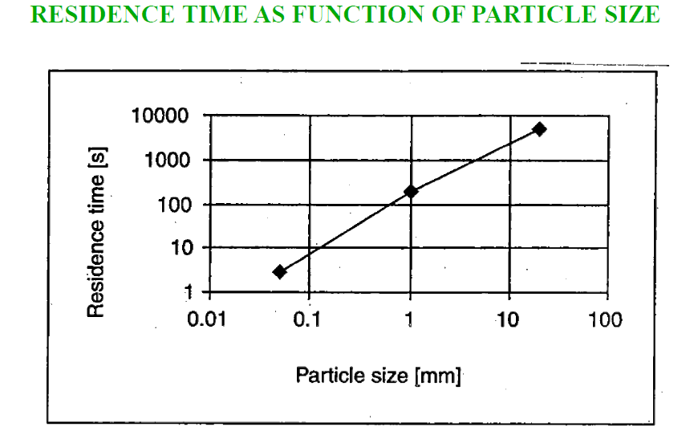
Coal Gasification Theory Contd..
16

Slide 17
Coal Gasification Theory Contd..
17

Slide 18
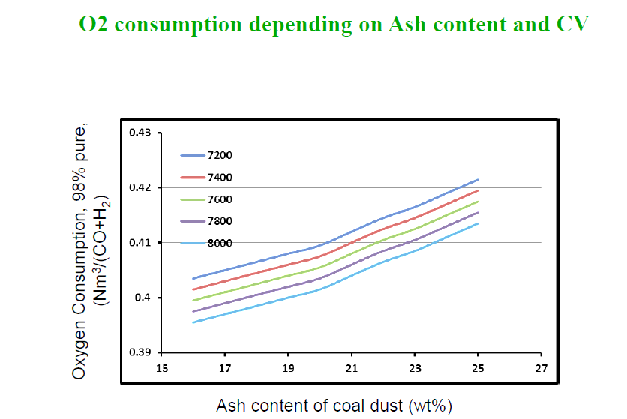
Coal Gasification Theory Contd..
18

Slide 19
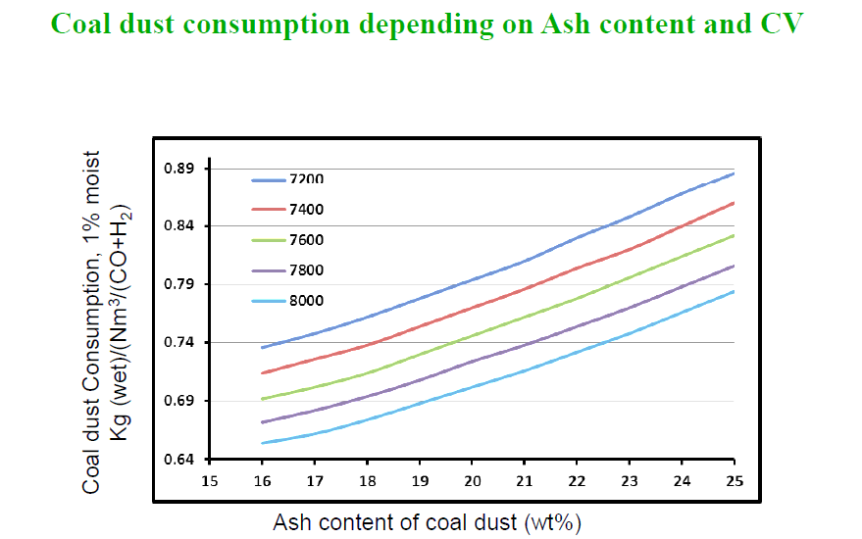
Coal Gasification Theory Contd..
19

Slide 20
Coal Gasification Theory Contd..
EFFECT OF PRESSURE
Synthesis gas composition changes with pressure
Methane and CO2 content go up with increasing pressure
H2 and CO content go down
However, at high temperatures (1500⁰C) the change in gas composition with pressure is negligible.
20

Slide 21
Coal Gasification Theory Contd..
21

Slide 22
Coal Gasification Theory Contd..
22

Slide 23
Coal Gasification Theory Contd..
23

Slide 24
Coal Gasification Theory Contd..
Category | Moving Bed |  | Fluidized Bed |  | Entrained flow
Ash Condition | Dry Ash | Slagging | Dry ash | agglomerating | slagging
Typical Processes | Lurgi | BGL | Winkler/HTW /CGB | KRW U-Gas | Shell, Texaco, E-Gas, Noell,KT
Feed Characteristics
Size | 6-50 mm | 6-50 mm | 6-10 mm | 6-10 mm | < 100 µm
Acceptability of fines | Limited | Better than dry ash | Good | Better | Unlimited
Acceptability of caking coal Preferred coal rank | Yes (with stirrer) any | Yes high | Possibly Low | Yes any | Yes any
Operating Characteristics
Outlet gas temp | Low (425-625⁰) | Low (425-625⁰C) | Moderate (950-1050⁰C) | Moderate (950-1050⁰C) | High (1250-1600⁰C)
Oxygen demand | Low | Low | Moderate | Moderate | High
Steam Demand | High | low | Moderate | Moderate | low
Other Characteristics | Hydrocarbon in gas | Hydrocarbon in gas | Lower carbon conversion | Lower carbon conversion | Pure gas high carbon conversion
24

Slide 25
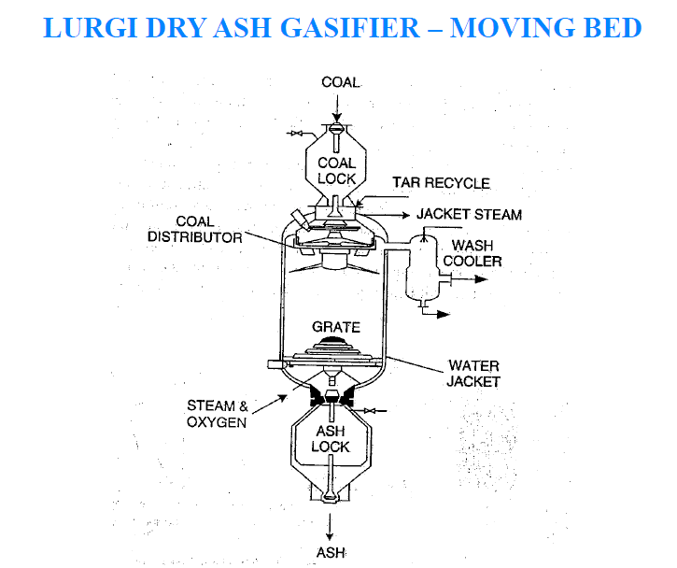
Coal Gasification Theory Contd..
25

Slide 26
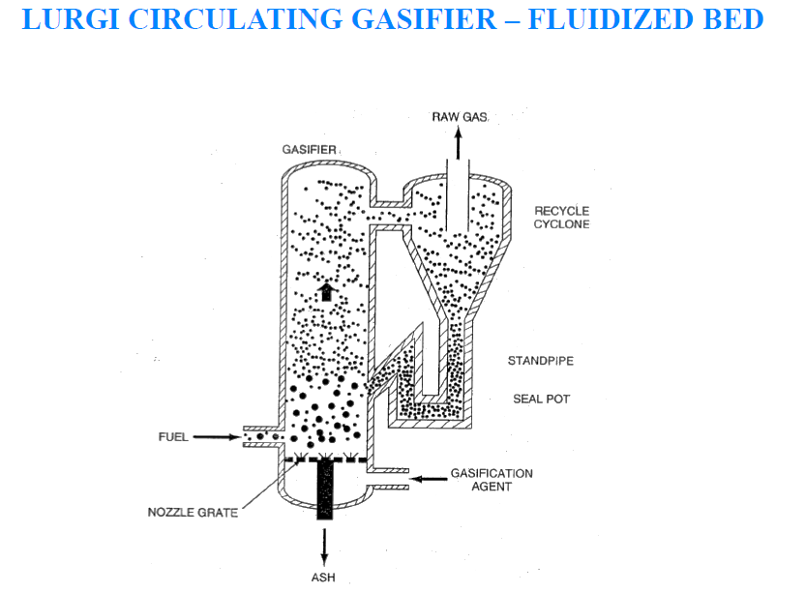
Coal Gasification Theory Contd..
26

Slide 27
Coal Gasification Theory Contd..
27

Slide 28
28

Slide 29
29

Slide 30
30

Slide 31
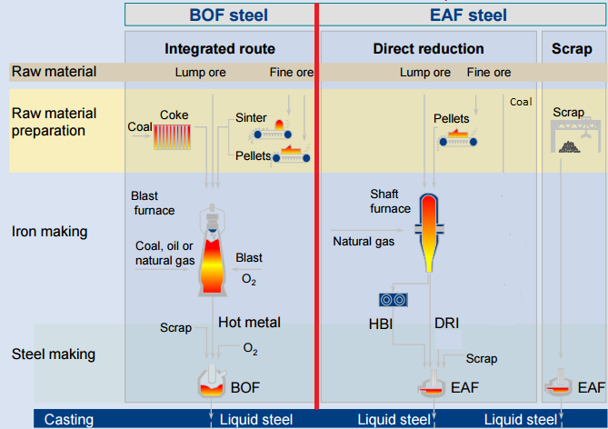
Selection of Coal Gasification Technology
Major Iron Making routes
Selection of Coal Gasification Project
Heavy Import of Costly Coking Coal
Both of the Current Clean Conventional Routes of Iron making are somehow dependent on Imports.
However, JSPL also being a supporter of “Make In India” Ideology, tried to use non-coking coal in Clean Steel making.
Same is abundantly available in India & can be used effectively.
SynGas
Shortage in Indian Sub-Continent
Copyright © 2017 Jindal Steel & Power Ltd.

Slide 32
Selection of Coal Gasification Technology contd..
Blast Furnace Route
Gas Based
Coal Based
Centuries old conventional route
In India, Metallurgical coal reserves are limited & thus expensive Coking Coal need to be imported
Clean Technology
Capital cost is comparatively higher
Energy Requirement is 20% less than that of rotary kiln based
Product suits best steel making qualities
DRI fines (-5mm) generated is 5%. Thus, Loss in SMS are less due to low % of fines
Sulphur content in DRI is in range of 0.003-0.01%
Metallization is 92-94%
Prone to pollution
Low Capital Cost
High Energy Requirement
Not suitable for making quality steel ( for flat products)
DRI fines (-3mm) generated is 30-40%. Thus, Loss in SMS are more due to high % of fines
Sulphur in coal is partly attached to DRI & partly goes to atmosphere as SO2 contributing to air pollution
Metallization is 86-90%
Direct Reduced Iron (DRI)
Abundantly available non-coking coal in country can be used effectively
Cost of production is low
Overall Investment is low
32

Slide 33
Selection of Coal Gasification Technology contd..
Blast Furnace Route
Gas Based
Coal Based
Reformed Natural Gas
× In India Natural Gas availability is limited & not readily available
Coke Oven Gas
× Coke Oven Gas & Corex Gas are localized & not sufficient
Corex Gas
Direct Reduced Iron (DRI)
India has abundant non-coking coal
Therefore, the only optimum alternate way is Gasification of these coal to produce Syn-Gas for DRI production.
Syn-Gas from Coal Gasification
33

Slide 34
Types of Gasification Technologies
Technology evaluation & Comparison
Various Gasification Technologies were considered and evaluated mainly on the basis of Commercial Scale Demonstration, Capital Cost & Operational Cost:
Moving/Fixed Bed (Counter- Current, Co-current)
Fluidized bed
Entrained Flow
i) Dry Pulverized solid fuel
ii) Fuel Slurry
iii) Atomized Liquid Fuel
 | FEATURES | Fixed Bed | Fluidized Bed | Entrain Bed
1. a) | Pressure , Kg/cm2 | 10-30 | Atm | 30-40
b) | Temperature deg C | 1200 | 1100 | 1600
c) | Gas-outlet Temp, deg C | 675 | ~850 | 1370
2 | Type of Coal | All ranks | Low rank coal | All types
3 | Feed coal size, mm | 6 - 50 | 0 - 9.5 | ~200 mesh
4 | Moisture in feed Coal, wt% | up to 18 |  | <5
5 | Maximum ash content, wt% | up to 40 | up to 35 | up to 25
6 | Ash withdrawal | Dry Powder | Dry Powder | Molten Slag
7 | Dry gas composition, vol%
 | CO | 18-20 | 34-36 | 65-66
 | H2 | 39-41 | 40-42 | 30-32
 | CH4 | 10-12 | 3-4 | 0.4
 | CO2 | 28-30 | 19-20 | 1-2
 | S ' Compounds | ~0.5 | ~0.5 | 0.4
 | N2 and others | ~0.5 | 1 | 1
8 | H2/CO ratio in gas | 2.1 | 1.25 | 0.48
9 | Calorific value of gas, kcal / Nm3 | 2600-3400 | 2640 | 2980
10 | Cold Gas efficiency, % | >85 |  | 80-83
11 | Carbon Conversion, % | 93-99 |  | >93
Copyright © 2014 Jindal Steel & Power Ltd.

Slide 35
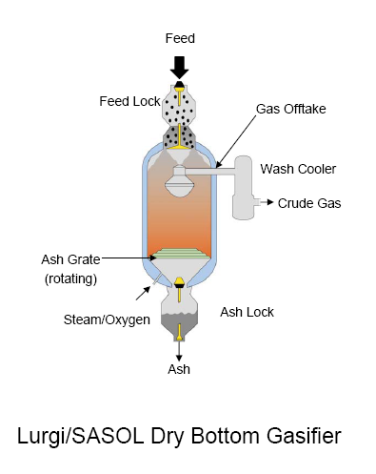
Selection of Fixed Bed Technology
Well demonstrated, mature and Proven Technology with low risk. More than 100 Gasifiers in operation excl. China.
Suitable for low Rank, high ash content Coal.
High Carbon conversion efficiency (approx. 95%).
High Cold Gas efficiency (85%) due to counter-current operation.
Low Oxygen consumption.
Gas Composition suitable for steel Industry.
Ash fusion temperature of Indian Coal is high, therefore, dry bottom type is preferred.
No Coal drying & grinding required, hence less energy consumption & not hazardous.
Valuable By-Products like Tar, Oil, Phenol, Ammonia etc.
Fixed Bed Dry Bottom Gasifier

Slide 36
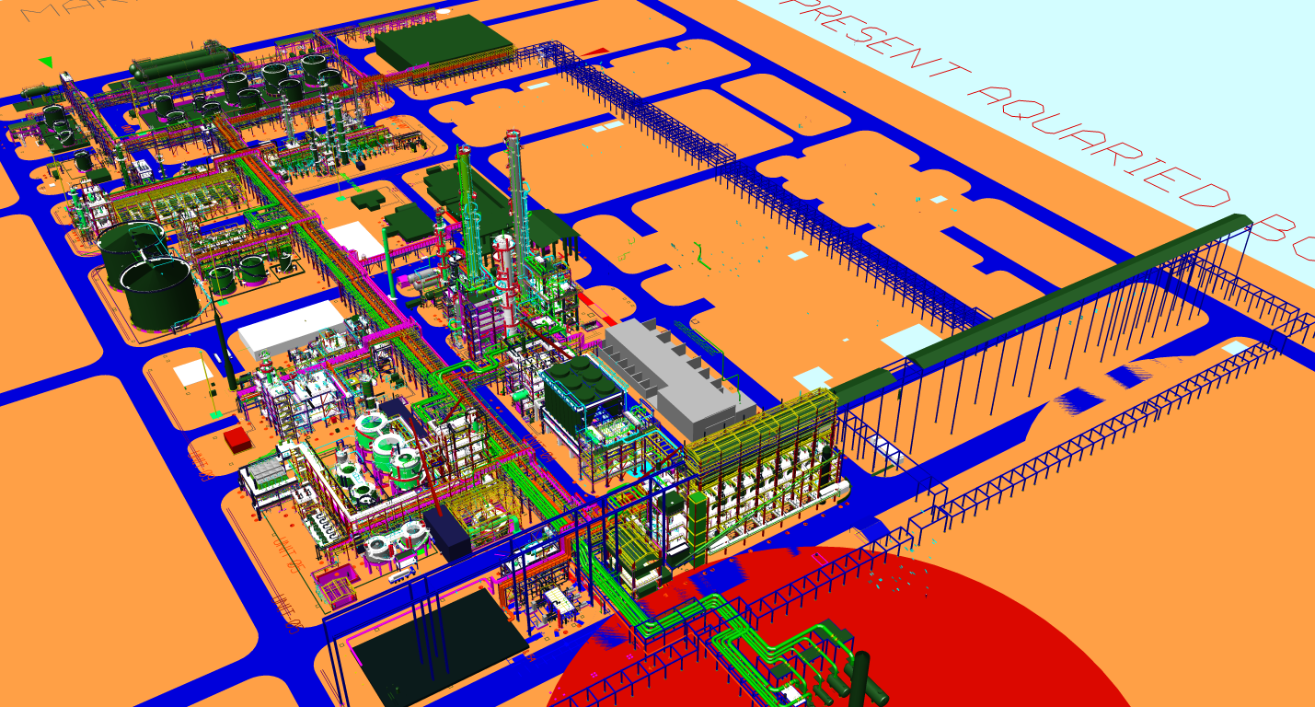
Coal Gasification Complex at a Glance
Tank Farm
Ammonia Recovery
RECTISOL
Phenosolvan
GAS COOLING
To DRI
GASIFICATION
SULPHUR RECOVERY
Gas liquor Separation
COAL
STEAM+ OXYGEN
DM-7th Sep’2013 V0

Slide 37
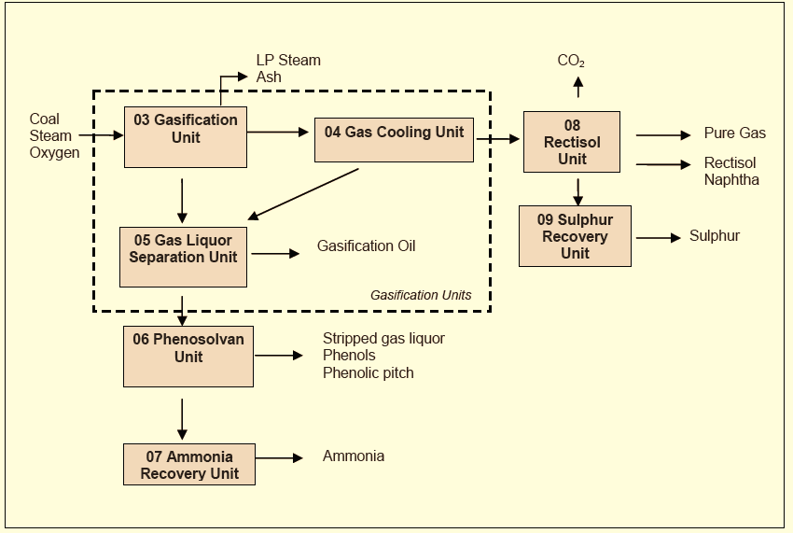
Syn-gas Production route & Units in CGP
JINDAL Plant
Gasifiers - 7 (6+1)
Coal Required - 2.4 MMTPA
Syn-gas Production -225,000 Nm3/hr.
Syn-gas Utilization –
a) DRI - 160,000 Nm3/hr
b) Fuel gas – 47,000 Nm3/hr
5. Liquid By-products - 125,000 MTPA.
Copyright © 2014 Jindal Steel & Power Ltd.

Slide 38
Syn Gas Integration Route to DRI
Coal
Heavy Fuel Oil
Pet Coke
Naptha
Recycle Gas
Iron Ore
Gasifier
Gas Cleaning & Conditioning
CO₂ Removal
Scrubber
O₂
MIDREX Shaft Furnace
Air Separation Plant
Reducing Gas
Gas Heater
DRI/HBI
Gasification plant
MIDREX Direct Reduction Plant
Copyright © 2014 Jindal Steel & Power Ltd.

Slide 39
CLEAN COAL SPECIFICATION

Slide 40
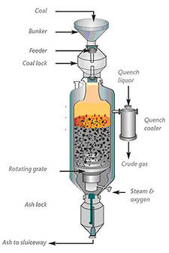
Gasification – Process overview
Gasification Unit
Sasol-Lurgi gasification is a moderate temperature and pressure process.
Coal is Gasified typically at a pressure of 29.0 Bar in presence of high pressure steam & pure oxygen to produce syngas for further purification & use.
Raw Gas (400- 450ºc) immediately quenched with hot gas liquor to approximately 200ºc then it is cooled in Primary Waste Heat Boiler (PWHB) to 190ºC.
Note:- Gasification is the conversion by partial oxidation at elevated temperature of a carbonaceous material into a combustible gas termed as Synthesis gas
The Synthesis gas contains CO, CO2, H2, CH4 and traces of higher hydrocarbons etc.

Slide 41
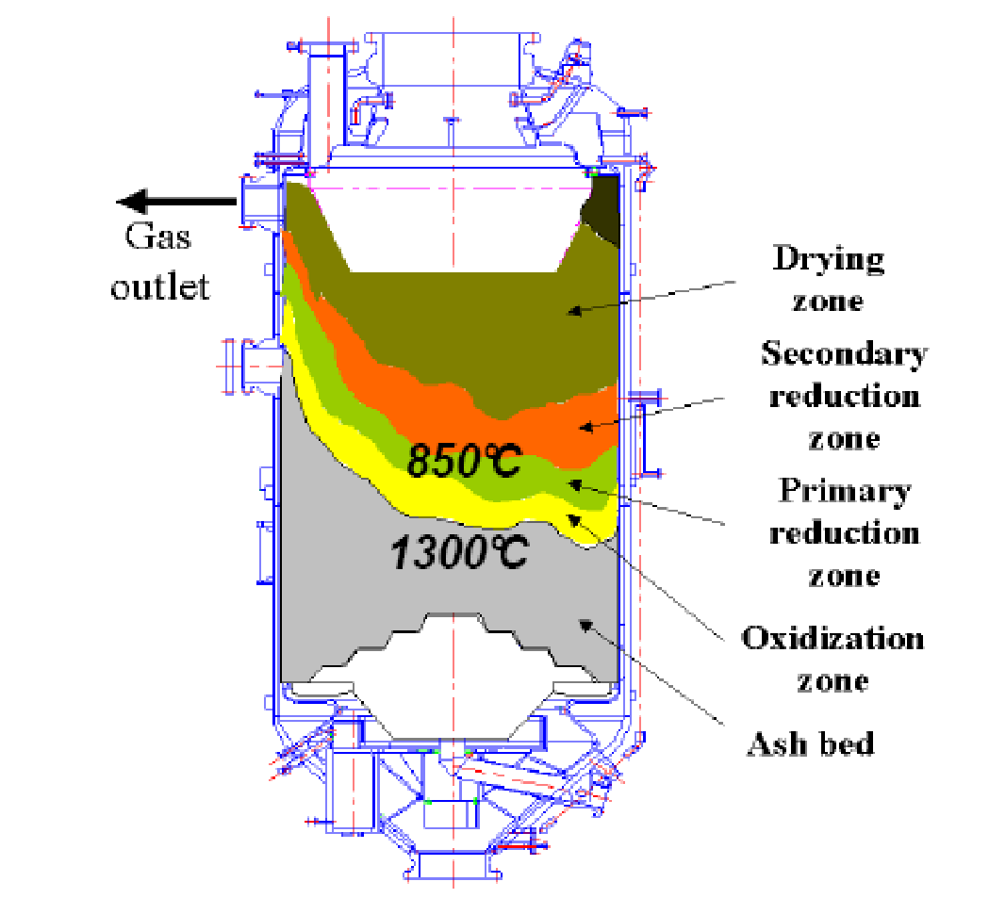
Gasification – Process overview contd..
Drying: (~200°C)The wet screened coal is dried & heated up
Carbonization Zone: (500~600°C The volatiles contains in coal are driven out
Gasification Zone: (~800°C)
C + H₂O = CO + H₂ -118.5 kJ/mol
Combustion Zone: (~1200°C)
C + O₂ = CO₂ + 405.5 kJ/mol
C + ½ O₂ = CO + 122.9 kJ/mol
Ash Bed: Ash is cooled and agent is heated

Slide 42
GASIFICATION FRONT VIEW
COAL BUNKER
PRIMARY WASTE HEAT BOILER
COAL LOCK
GASIFIER
WASH COOLER
ASH LOCK
SLUICEWAY

Slide 43
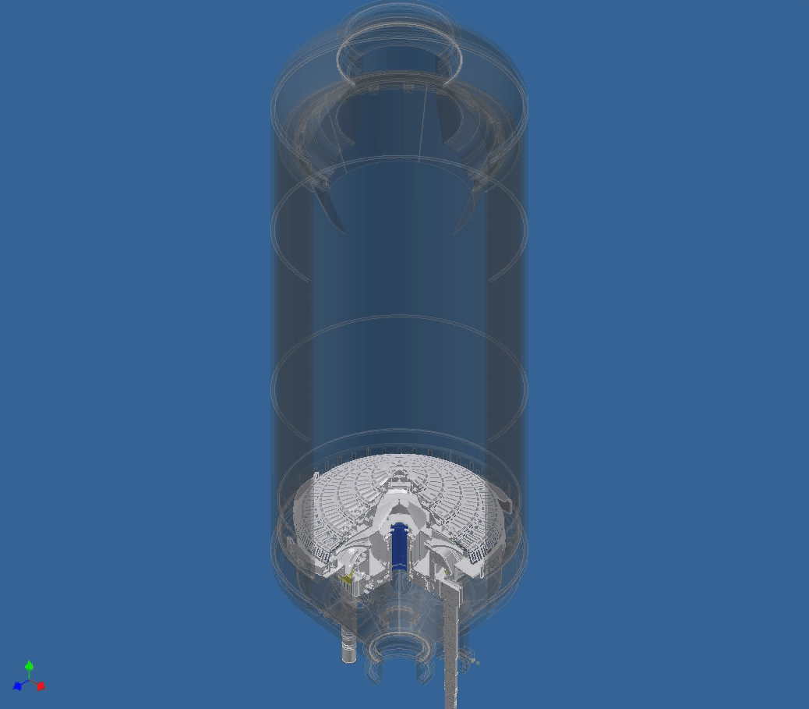
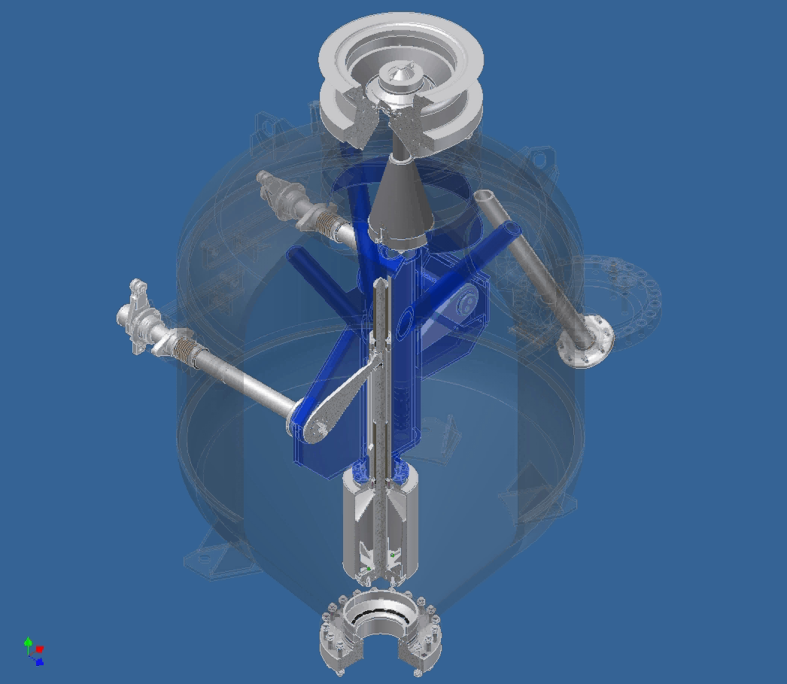
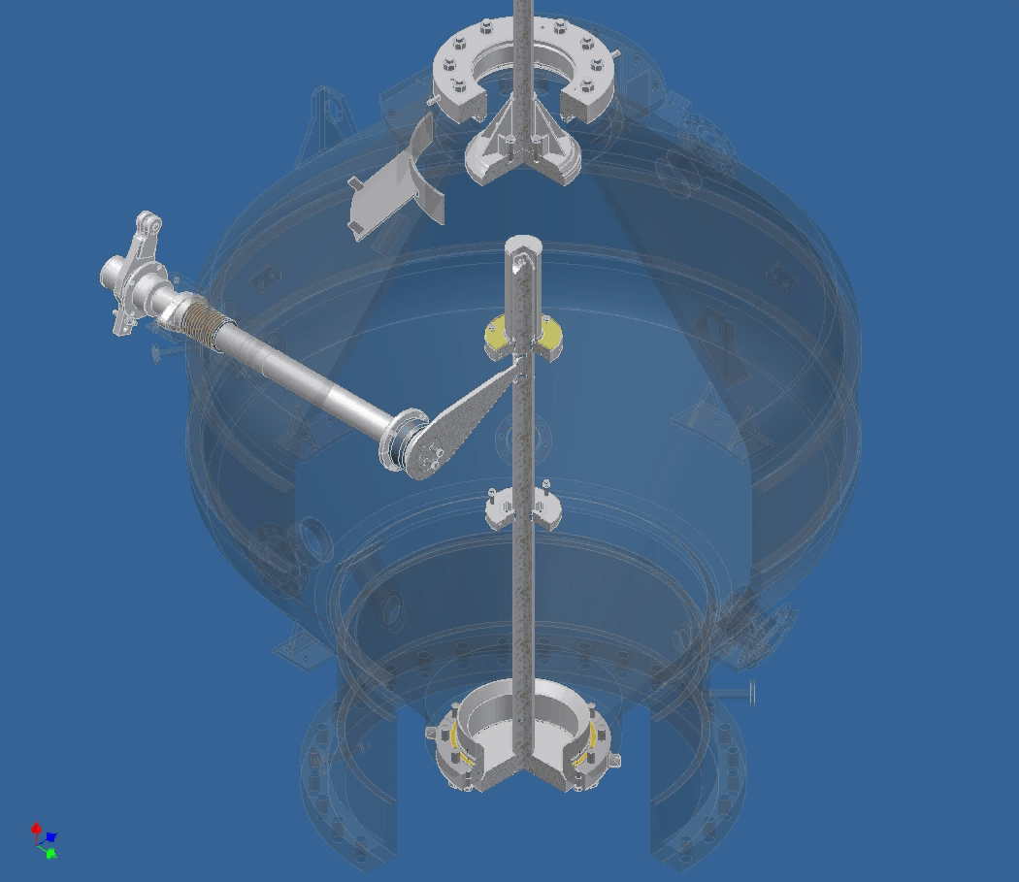
Gasification – Process overview contd..

Slide 44
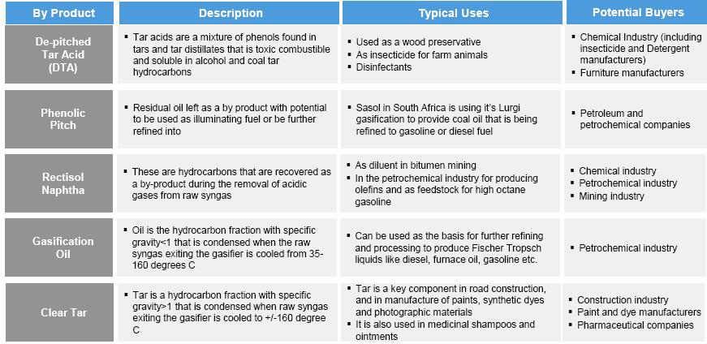
Gasification By Products

Slide 45
Gasification By Products contd..

Slide 46
International Price of Ammonia 2019（$/T）
Gasification By Products contd..
Month | Middle east FOB | India CFR | Tanpa CFR | USA Gulf CFR
Jan-2019 | 290 | 340 | 293 | 298
Feb-2019 | 269 | 306 | 285 | 290
Mar-2019 | 250 | 294 | 278 | 283
April-2019 | 243 | 282 | 267 | 265
May-2019 | 213 | 254 | 235 | 240
June-2019 | 199 | 240 | 220 | 225
July-2019 | 198 | 238 | 215 | 220

Slide 47
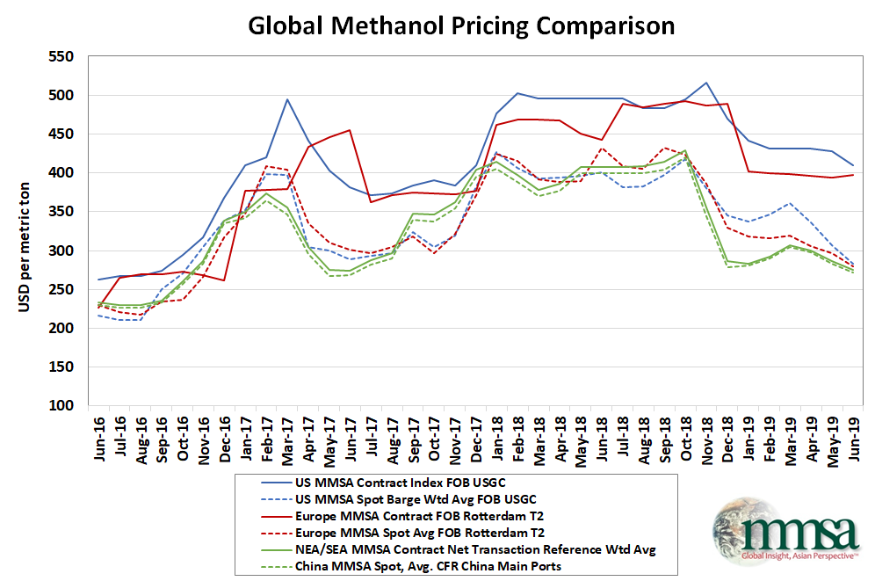
Methanol Market Assessment of key global pricing and supply/demand figures by Methanol Market Services Asia (MMSA)
Gasification By Products contd..

Slide 48
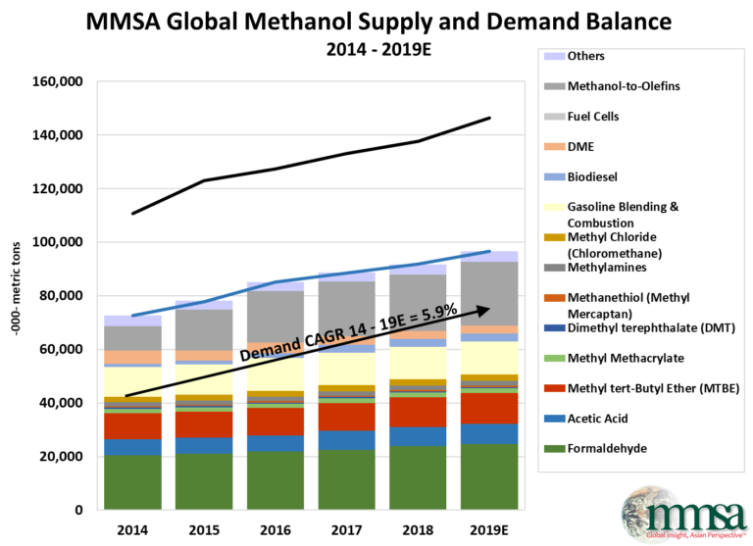
Gasification By Products contd..

Slide 49
49

Slide 50
50

Slide 51
Gasification Unit

Slide 52
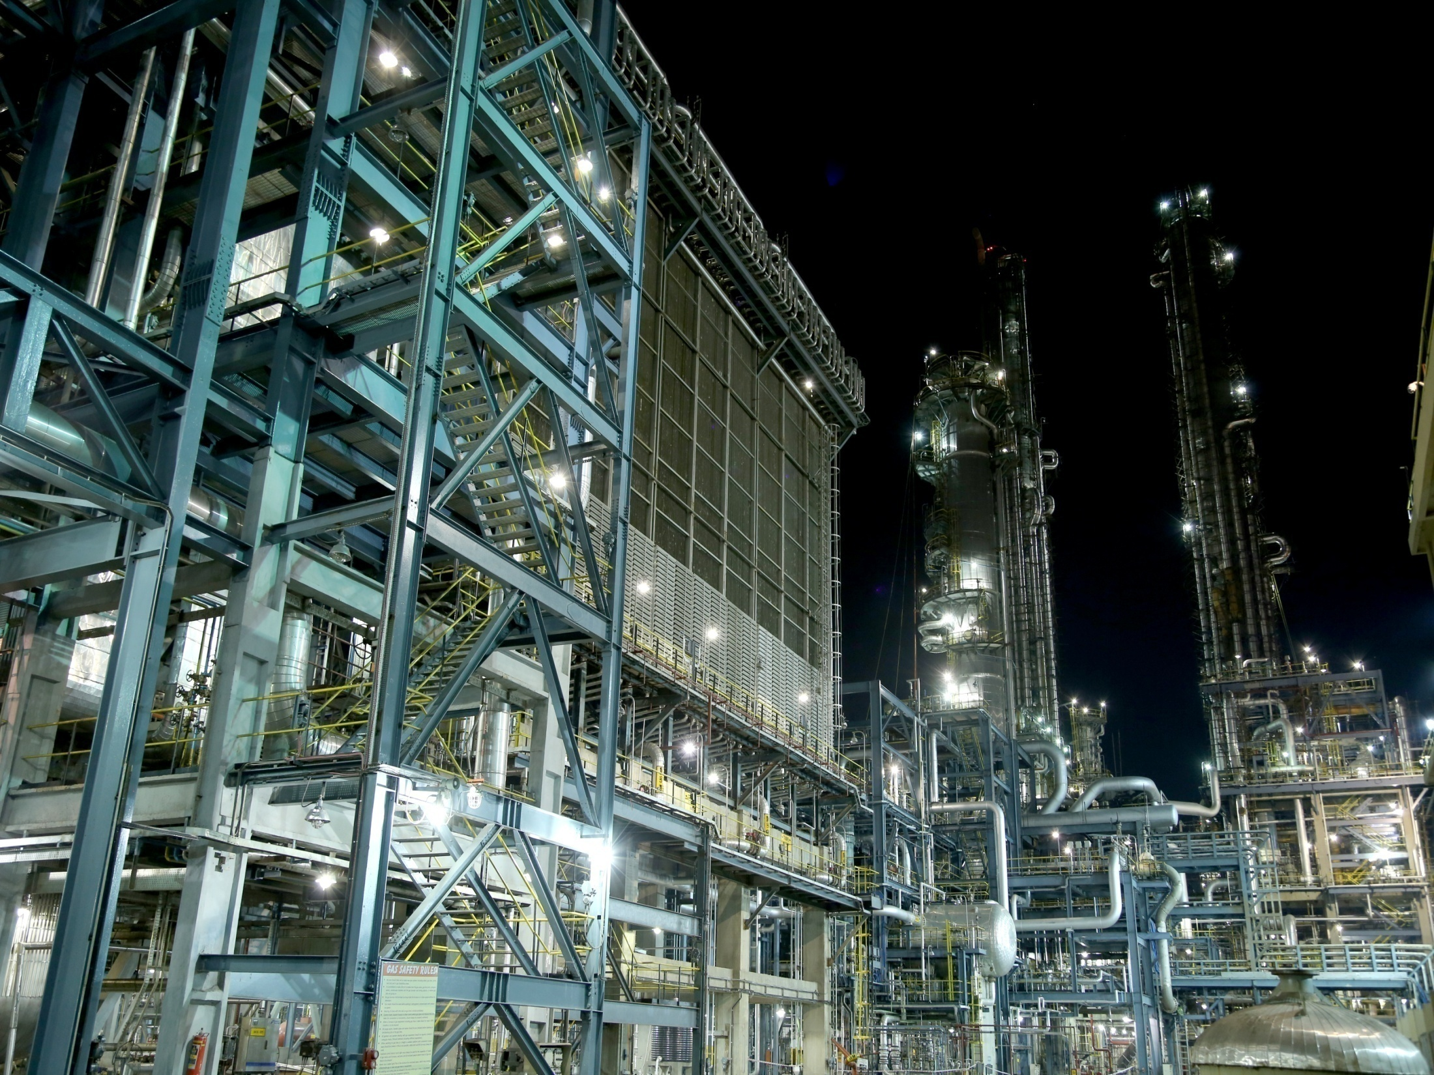
Gas Cooling Unit

Slide 53
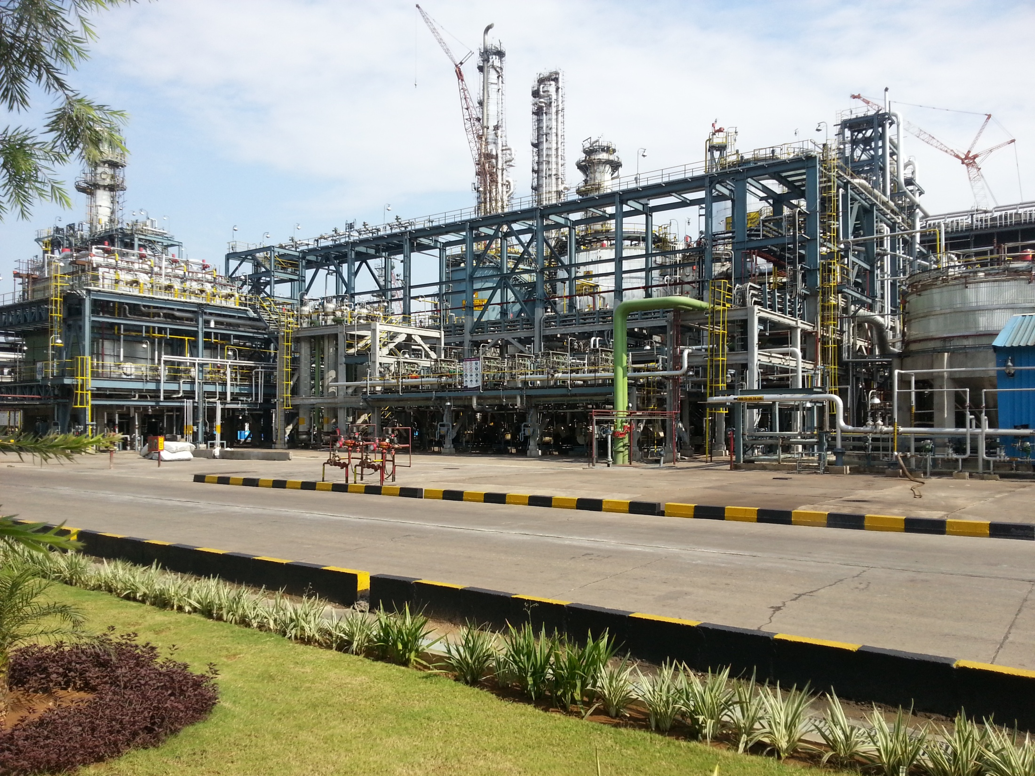
Gas Liquor Separation Unit

Slide 54
Rectisol

Slide 55
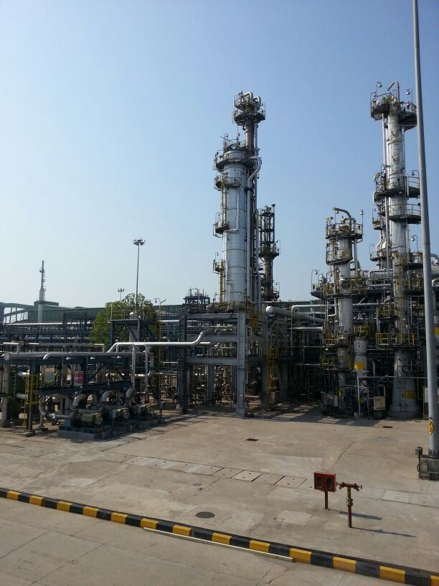
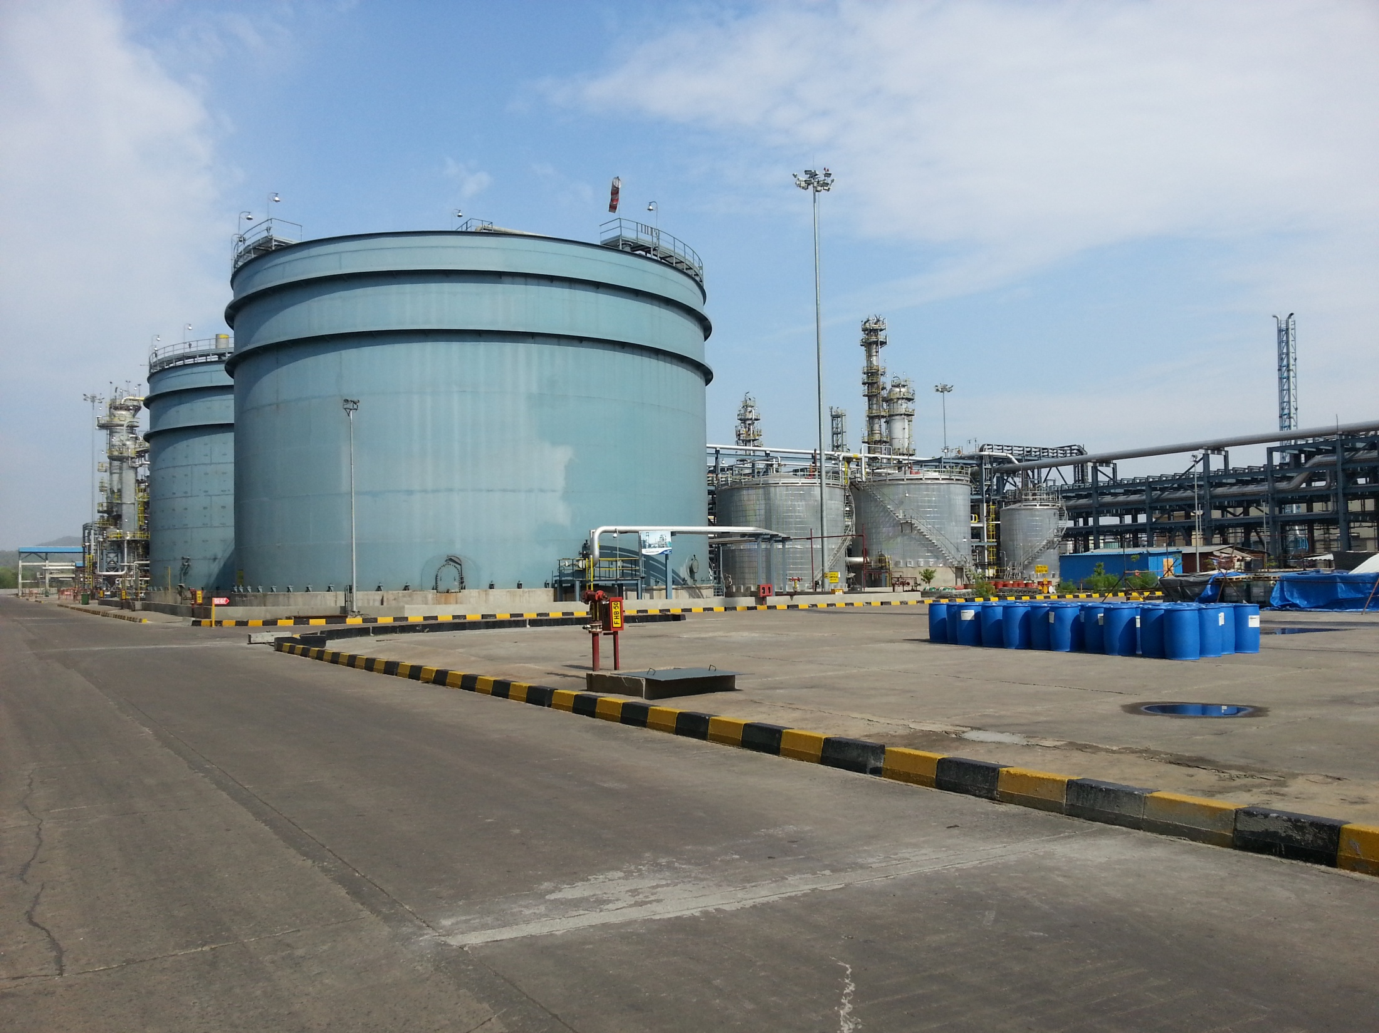
Phenosolvan unit
Phenol Recovery

Slide 56
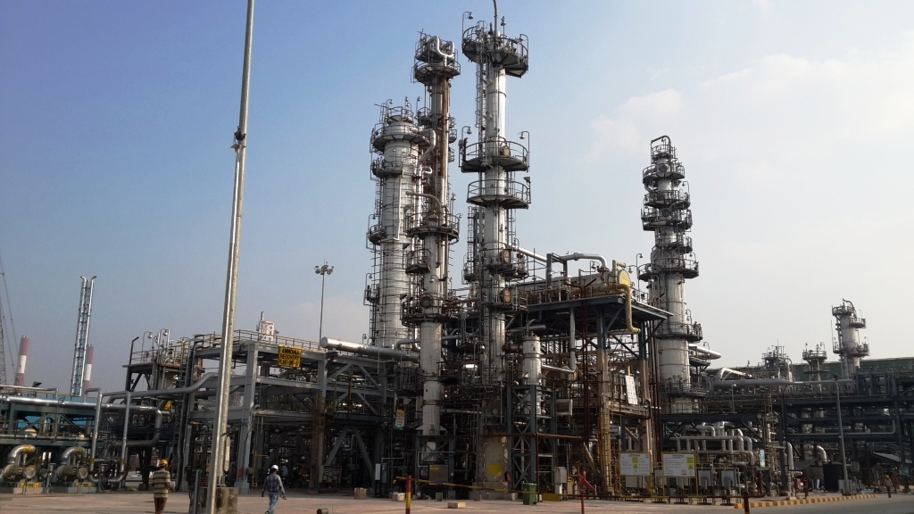
Ammonia Recovery Unit

Slide 57
Sulphur Recovery Unit

Slide 58
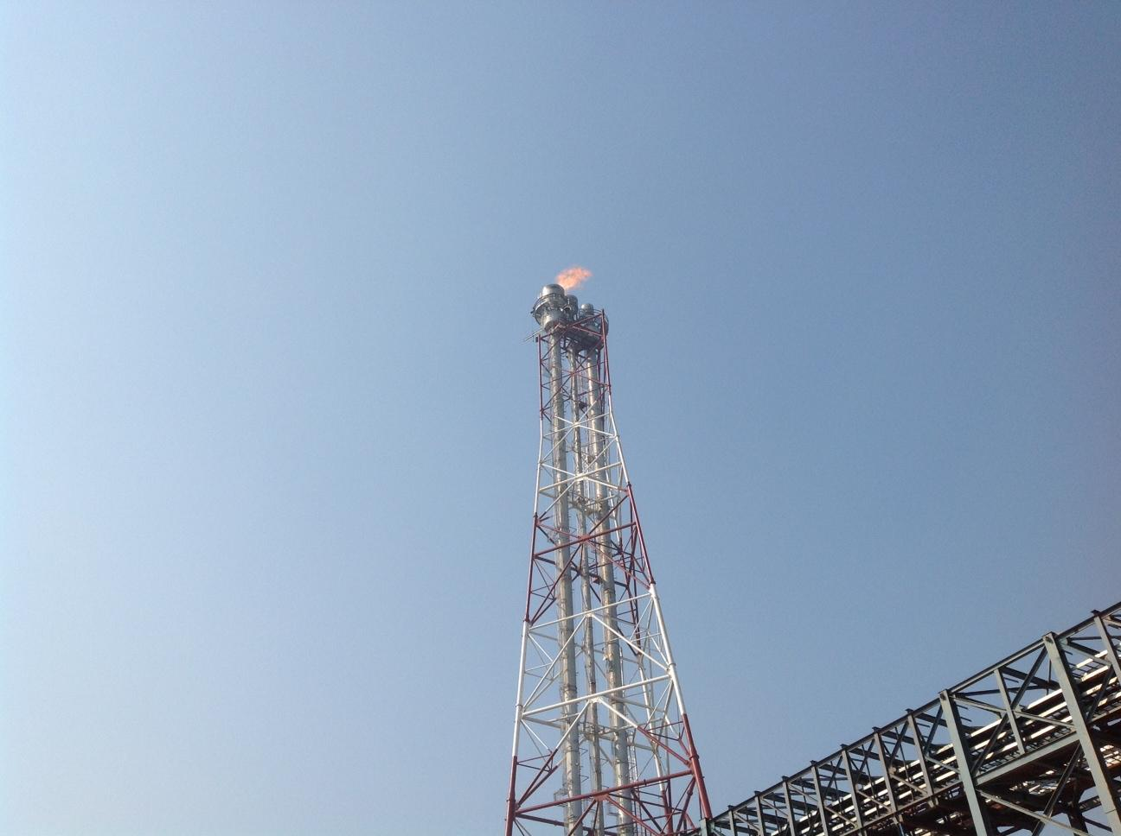
Flare Stack

Slide 59
THANK YOU
Copyright © 2017 Jindal Steel & Power Ltd.

